Slide 1
Causes and Mitigations of Unreproducible Builds in Java
Canonicalization for Unreproducible Builds in Java
Aman Sharma, Benoit Baudry, Martin Monperrus

Slide 2
xz-utils attack
malicious.m4
liblzma.deb
liblzma.deb
github.com/tukaani-project/xz
github/releases/source.tar.xz
github/releases/source.tar.xz
Consumer
Build
liblzma.rpm
liblzma.rpm
[1] J. Malka, ‘How NixOS and reproducible builds could have detected the xz backdoor for the benefit of all’. Available: https://luj.fr/blog/how-nixos-could-have-detected-xz.html
19-11-2025
Aman Sharma | amansha@kth.se

Slide 3

Reproducible Builds
Source + Dependencies
Output 1
Output 2
Identical
[2] Chris Lamb and Stefano Zacchiroli. 2022. Reproducible Builds: Increasing the Integrity of Software Supply Chains. IEEE Software 39, 2 (March 2022), 62–70. https://doi.org/10.1109/MS.2021.3073045
19-11-2025
Aman Sharma | amansha@kth.se

Slide 4
xz-utils mitigation
malicious.m4
github/releases/source.tar.xz
github.com/tukaani-project/xz
Build
Not identical!
Diff
/home/aman/source.tar.xz
Rebuild
19-11-2025
Aman Sharma | amansha@kth.se

Slide 5
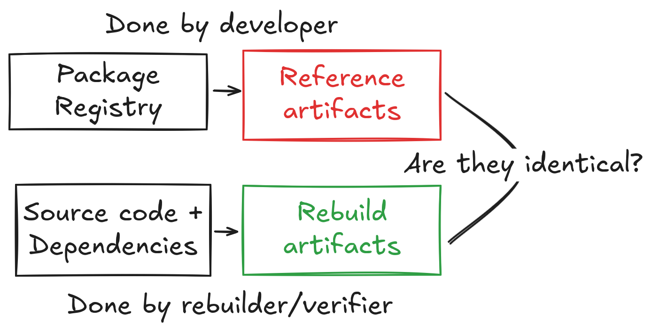
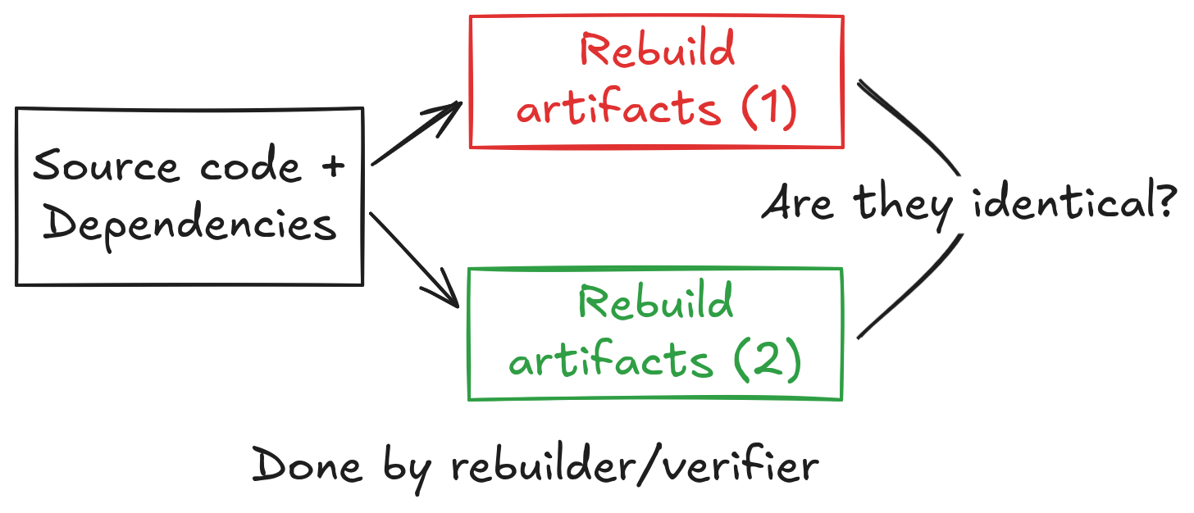
How to check for reproducible builds?
Build twice and compare
Build and compare with package registry
[3] G. Benedetti et al., ‘An Empirical Study on Reproducible Packaging in Open-Source Ecosystems’, 57th International Conference on Software Engineering, 2025.
[1] J. Malka, S. Zacchiroli, and T. Zimmermann, ‘Does Functional Package Management Enable Reproducible Builds at Scale? Yes’, in 22nd International Conference on Mining Software Repositories, Ottawa
19-11-2025
Aman Sharma | amansha@kth.se

Slide 6
Related Work: build twice and compare
[4] G. Benedetti et al., ‘An Empirical Study on Reproducible Packaging in Open-Source Ecosystems’, presented at the Proceedings of the 47th International Conference on Software Engineering, 2025.
Summary: Checking if builds are reproducible for RubyGems, PyPI, Maven.
[5] Z. Ren, H. Jiang, J. Xuan, and Z. Yang, ‘Automated localization for unreproducible builds’, in Proceedings of the 40th International Conference on Software Engineering, 2018
Summary: Localizing files that differ in two subsequent builds for Debian packages.
[6] O. S. Navarro Leija et al., ‘Reproducible Containers’, in Proceedings of the Twenty-Fifth International Conference on Architectural Support for Programming Languages and Operating Systems, 2020
Summary: Wrapper around the build process for debian packages.
19-11-2025
Aman Sharma | amansha@kth.se

Slide 7
Related Work: build and compare with package registry
[7] J. Malka, S. Zacchiroli, and T. Zimmermann, ‘Does Functional Package Management Enable Reproducible Builds at Scale? Yes’, in 22nd International Conference on Mining Software Repositories, 2025.
Summary: Rebuild and verified 700K nix packages. 91% of them are reproducible.
[8] R. Bajaj, E. Fernandes, B. Adams, and A. E. Hassan, ‘Unreproducible builds: time to fix, causes, and correlation with external ecosystem factors’, Empirical Softw. Engg, 2023.
Summary: Reproducibility and survival analysis of Debian and Arch Linux packages. Debian packages takes longer to become reproducible but stay reproducible for longer.
[9] V. Andersson, Geth Rebuild : Verifiable Builds for Go Ethereum. 2024
Summary: Rebuilds ethereum client that enables connection to the main ethereum network.
We like this approach more as it maximizes environment differences!
19-11-2025
Aman Sharma | amansha@kth.se

Slide 8
Reproducible/Verifiable/Accountable builds
Verifiable Builds: Builds are verifiable if the build process of a software can be fixed to output bit-by-bit identical artifacts.
Accountable Builds: Builds are accountable if it can be explained why build process outputs unequal artifacts [10].
Basically, both of them are reproducible builds with extra steps hence we choose Reproducible Builds in our entire study.
We always prefer “Reproducible Builds” over other terms.
[10] T. Pohl, P. Novák, M. Ohm, and M. Meier, ‘SoK: Towards Reproducibility for Software Packages in Scripting Language Ecosystems’, Mar. 27, 2025, arXiv: arXiv:2503.21705. doi: 10.48550/arXiv.2503.21705.
19-11-2025
Aman Sharma | amansha@kth.se

Slide 9
Why is it important?
Ensuring Integrity: Reproducible builds ensure that the executable corresponds to the source code (assuming source code can be audited) and hence is not tampered with. [11]
Faster builds: Dependent sources do not need to be rebuilt and dependent tasks do not need to be rerun if a rebuild of a package does not yield different results. [12]
[11] Mike Perry. 2013. Deterministic Builds Part One: Cyberwar and Global Compromise | Tor Project. https://blog.torproject.org/deterministic-builds-part-one-cyberwar-and-global-compromise/
[12] https://reproducible-builds.org/
19-11-2025
Aman Sharma | amansha@kth.se

Slide 10
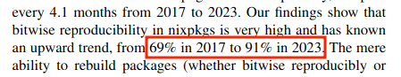
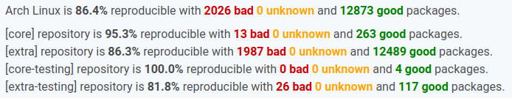
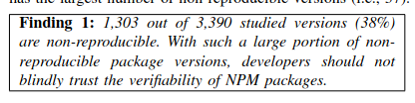
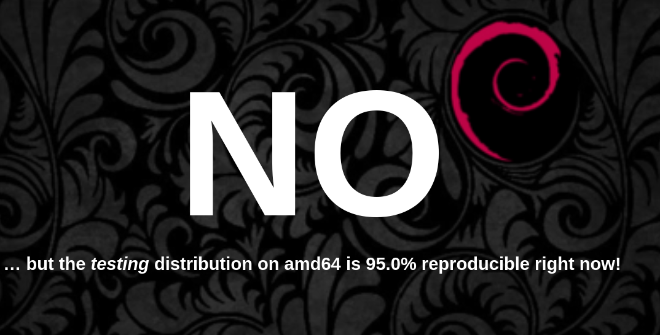
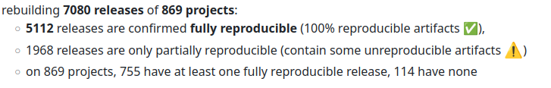
Are builds reproducible yet?
[14]
[13] P. Goswami, S. Gupta, Z. Li, N. Meng, and D. Yao, ‘Investigating The Reproducibility of NPM Packages’, in 2020 IEEE International Conference on Software Maintenance and Evolution (ICSME)
[14] https://isdebianreproducibleyet.com/
19-11-2025
Aman Sharma | amansha@kth.se
Notes:
https://reproducible.archlinux.org/
https://tests.reproducible-builds.org/debian/reproducible.html
Nix paper

Slide 11
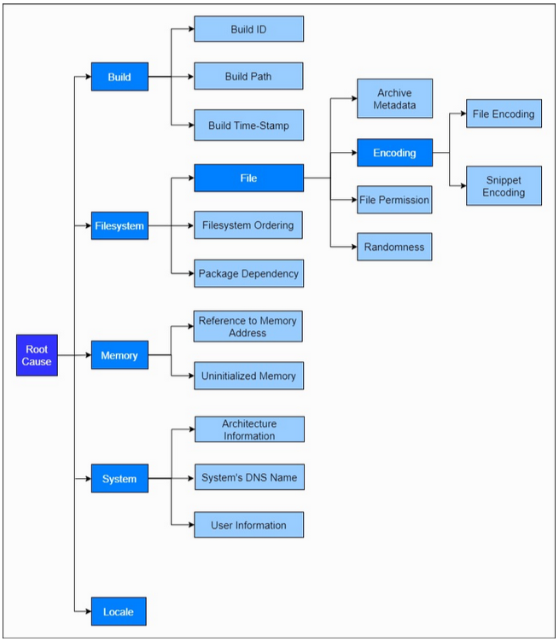
Why aren’t builds reproducible?
Short answer: Timestamps, signature embedded
[15] R. Bajaj, E. Fernandes, B. Adams, and A. E. Hassan, ‘Unreproducible builds: time to fix, causes, and correlation with external ecosystem factors’, Empirical Softw. Engg.
19-11-2025
Aman Sharma | amansha@kth.se

Slide 12
What is the status of reproducible builds in Java?
Most closely related work:
[16]J. Xiong, Y. Shi, B. Chen, F. R. Cogo, and Z. M. (Jack) Jiang, ‘Towards build verifiability for Java-based systems’, in Proceedings of the 44th International Conference on Software Engineering: Software Engineering in Practice, in ICSE-SEIP ’22
1) Follows “build twice and compare” 2) Small and close sourced dataset
[16] P. Goswami, S. Gupta, Z. Li, N. Meng, and D. Yao, ‘Investigating The Reproducibility of NPM Packages’, in 2020 IEEE International Conference on Software Maintenance and Evolution (ICSME)
19-11-2025
Aman Sharma | amansha@kth.se

Slide 13
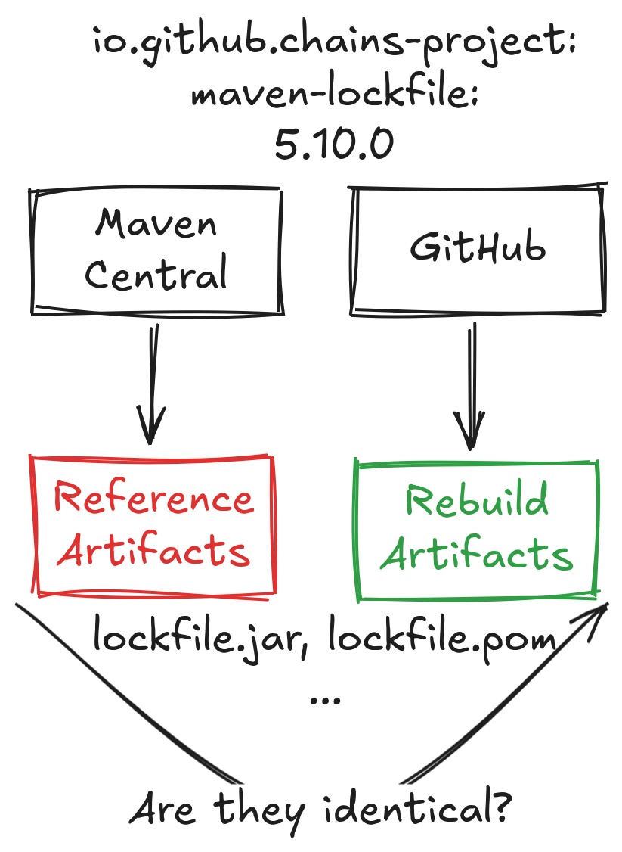
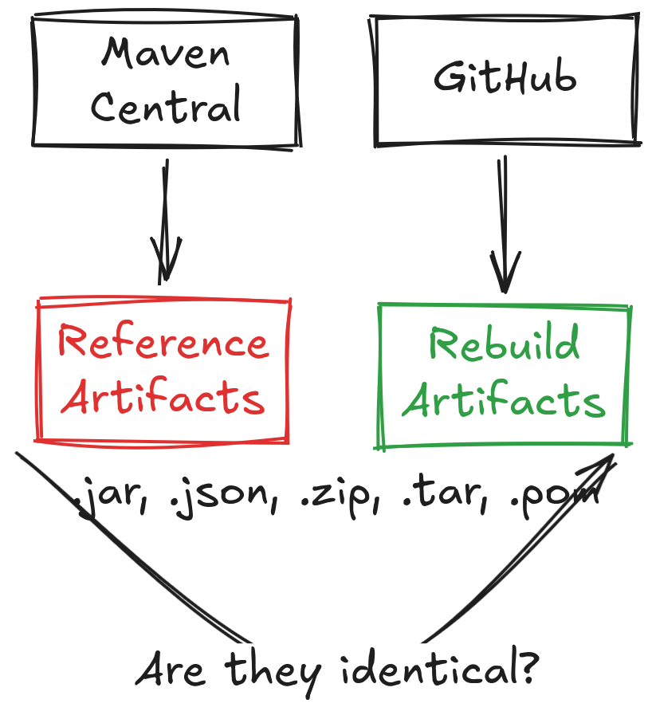
Reproducible Central
It is a GitHub repository: https://github.com/jvm-repo-rebuild/reproducible-central/
Artifacts like jar, .json, .zip files are downloaded from Maven Central.
Source code is downloaded from hosting services like GitHub.
The source code along with all of its build requirement is built using a “buildspec”.
Buildspec file is specification that lists how the build should done
Build command
Java version
Environment variables
If corresponding reference and rebuild artifacts are identical, project is marked reproducible.
[17] H. Boutemy, jvm-repo-rebuild/reproducible-central. (Oct. 31, 2024). jvm-repo-rebuild.
19-11-2025
Aman Sharma | amansha@kth.se

Slide 14
Our first goal
To build a taxonomy of reasons why unreproducible builds occur in Java and propose a fix for them
19-11-2025
Aman Sharma | amansha@kth.se

Slide 15
Dataset
We build our dataset on top of Reproducible Central - it is an infrastructure to verify whether Maven projects are reproducible.
Snapshot Reproducible Central on 8th October, 2024 (d280bf1)
706 Java projects and their buildspec files
We apply three filters that resulted in exclusion of projects
Projects that require manual intervention (eg. setting precise Java version).
Projects that have more artifacts built locally than on package registry (eg. some jars are are built locally but never released).
Projects that mapped artifacts incorrectly (eg. pom file is compared with jar).
Finally, we have
8,292 Maven releases of submodules
12,803 unreproducible artifact pairs
19-11-2025
Aman Sharma | amansha@kth.se

Slide 16
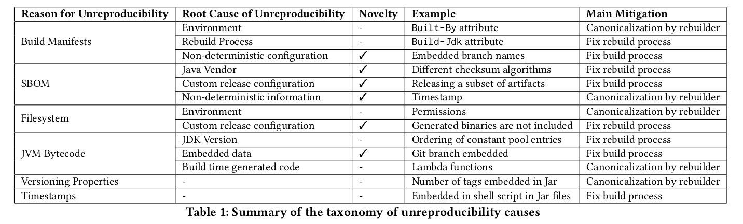
RQ1: Causes of Unreproducibility
19-11-2025
Aman Sharma | amansha@kth.se
Notes:
Why

Slide 17
Mitigation Strategies
There are 3 mitigation strategies
Fix the build process: repairing the build script used by developer to publish package
Pros: anyone can replicate the build with 0 ad-hoc configuration
Cons: sometimes you have to embed non-deterministic information like signatures
Fix the rebuild process: repairing the buildspec file
Pros: contributes to fixes in the build process
Cons: can be hard to adapt for future releases
Canonicalization: conversion of output artifacts into a standard representation that is free of non-deterministic changes
Pros: past releases can also be verified, no need to rebuild, “i can’t find a jdk 14 nowadays”
Cons: careful removal as it may mask meaningful differences
We try to evaluate canonicalization since few work in the literature
[18] J. Dietrich, T. White, B. Hassanshahi, and P. Krishnan, ‘Levels of Binary Equivalence for the Comparison of Binaries from Alternative Builds’
19-11-2025
Aman Sharma | amansha@kth.se

Slide 18
Example: Build Manifest
// rg.apache.camel:came-ahc-ws:3.13.0
// Built-By: name of user that built the artifact
-Built-By: root
+Built-By: aman
Mitigation: Fix build process or canonicalize
// org.apache.any23:apache-any23-csvutils:
2.7
-Specification-Title: Apache Any23 :: CSV Utilities
-Specification-Version: 2.7
-Specification-Vendor: The Apache Software Foundation
-Implementation-Title: Apache Any23 :: CSV Utilities
-Implementation-Version: 2.7
-Implementation-Vendor: The Apache Software Foundation
... some more attributes
19-11-2025
Aman Sharma | amansha@kth.se

Slide 19
Build Manifest mitigation
or
-Built-By: root
+Built-By: foo
-Built-By: root
// reference
-Built-By: root
// rebuild
+Built-By: aman
Diff between canonicalized artifact
Now Identical!
-Built-By: aman
+Built-By: foo
-Built-By: aman
Diff between original
reference and rebuild
artifacts
or
19-11-2025
Aman Sharma | amansha@kth.se

Slide 20
Example: Software Bill of Materials
// org.apache.commons:commons-parent:61
- <hash alg=\"SHA3-384\">289f952[TRUNCATED]</hash>
- <hash alg=\"SHA3-256\">32b50a7[TRUNCATED]</hash>
- <hash alg=\"SHA3-512\">1daf813[TRUNCATED]</hash>
Reason: Azul JDK had backported these hash algorithms.
Mitigation: Fix build process by correcting the Java vendor
19-11-2025
Aman Sharma | amansha@kth.se

Slide 21
Example: Filesystem
// io.github.albertus82:unexepack:0.2.1
// change in file permissions and owner
--rw-r--r-- root unexepack-0.1.1/unexepack.jar
+-rw-rw-r-- aman unexepack-0.1.1/unexepack.jar
Mitigation: Set permissions and owner to fixed value (canonicalization)
19-11-2025
Aman Sharma | amansha@kth.se

Slide 22
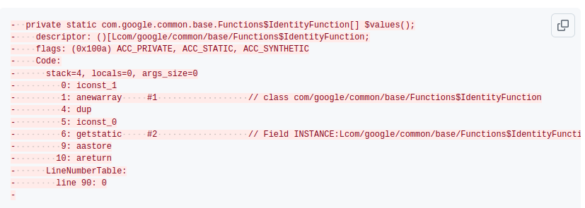
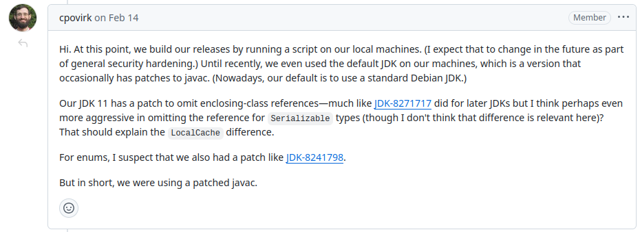
JVM bytecode
Mitigation: Hard to find JDK in such cases. It is better to consider two implementations equivalent (canonicalize).
[19] https://github.com/google/guava/issues/6321
19-11-2025
Aman Sharma | amansha@kth.se

Slide 23
Versioning Properties
// com.github.ldapchai:ldapchai:0.8.6
// Embedded in MANIFEST.MF
-SCM-Git-Branch: master
+SCM-Git-Branch: 338023a
// org.apache.drill:drill-opentsdb-storage:1.21.0
// Embedded in git.properties
-git.tags=drill-1.21.0
+git.tags=drill-1.21.0,drill-1.21.1,drill-1.21.2
Mitigation: Remove such attributes (canonicalization).
19-11-2025
Aman Sharma | amansha@kth.se

Slide 24
Timestamps
-#Wed Apr 20 20:27:41 CEST 2022
+#Fri Oct 18 03:03:44 UTC 2024
they can be embedded in the properties file
generated documentation
shell scripts appendix
executable binaries
software bill of materials
JVM bytecode
file metadata
MANIFEST.MF
NOTICE
servlets created by Jasper JSP compiler
Mitigation: Add `project.build.outputTimestamp` property to pom so that plugins can respect it (fixing build process)
19-11-2025
Aman Sharma | amansha@kth.se

Slide 25
RQ1: Causes of Unreproducibility
Takeaway: 6 main reasons of unreproducibility in Java
19-11-2025
Aman Sharma | amansha@kth.se
Notes:
Why

Slide 26
Our second goal
Analyze effectiveness of canonicalization in mitigating unreproducible builds
19-11-2025
Aman Sharma | amansha@kth.se

Slide 27
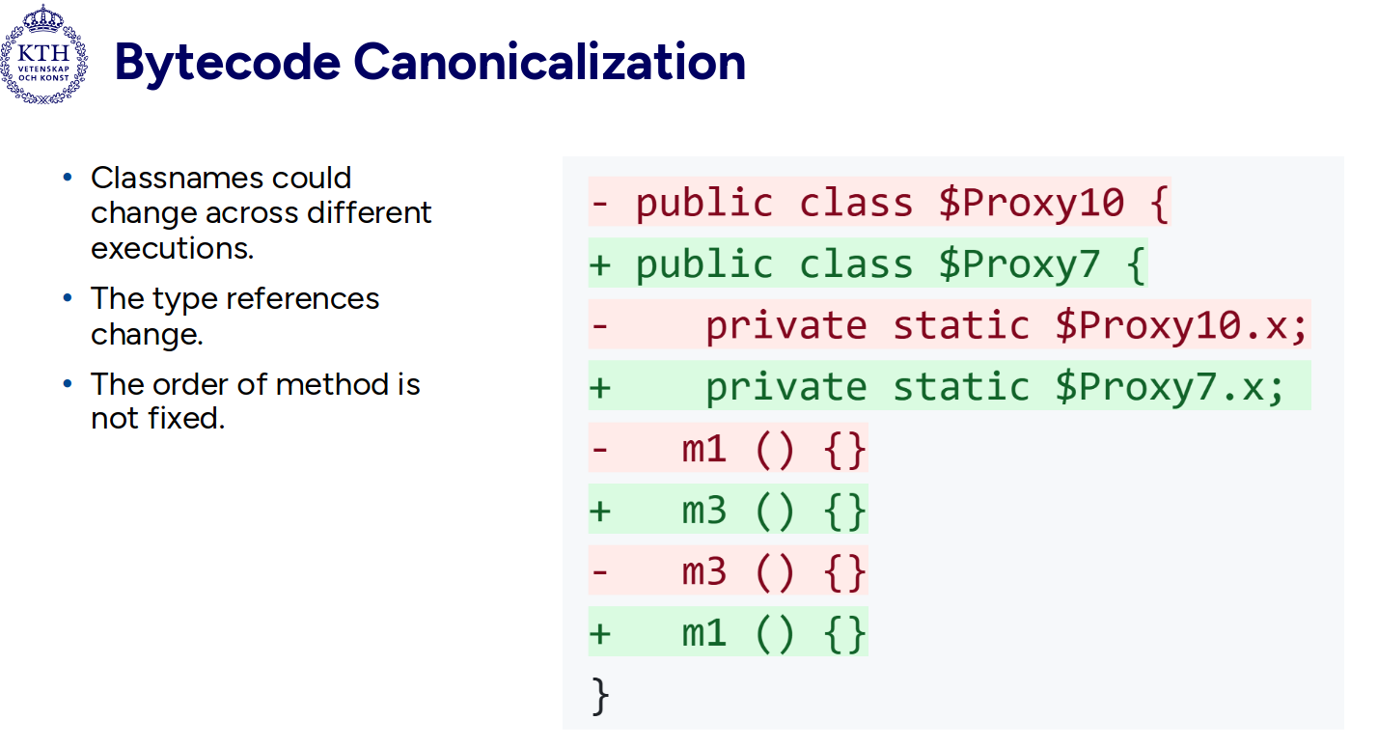
What is this term “canonicalization”?
Inspired by canonical URL. To choose the preferred, representative URL for a web page, helping search engines understand which version of a page should be indexed [19].
In our context, we create a preferred representation of the artifact which abstracts away non-deterministic differences.
Removing parts of artifacts
Setting fixed values
[20]
[20] https://support.google.com/webmasters/answer/10347851?hl=en
[21] A. Sharma, M. Wittlinger, B. Baudry, and M. Monperrus, ‘SBOM.EXE: Countering Dynamic Code Injection based on Software Bill of Materials in Java’, Jun. 28, 2024, arXiv: arXiv:2407.00246.
19-11-2025
Aman Sharma | amansha@kth.se

Slide 28
Artifact Canonicalization
Bytecode Canonicalization
It means that the entire artifact is transformed by removing non-deterministic and spurious changes, especially in metadata.
Eg. ordering of files in archive is made consistent
Tool used: OSS-Rebuild [21]
It is a process of transforming the bytecode of a program into a representation that is independent of specific implementation details inserted by the compiler.
Eg. implementation of string concatenation pre and post Java 9
Tool used: jNorm [22]
[22] https://github.com/google/oss-rebuild
[23] S. Schott, S. E. Ponta, W. Fischer, J. Klauke, and E. Bodden, ‘Java Bytecode Normalization for Code Similarity Analysis’
19-11-2025
Aman Sharma | amansha@kth.se

Slide 29
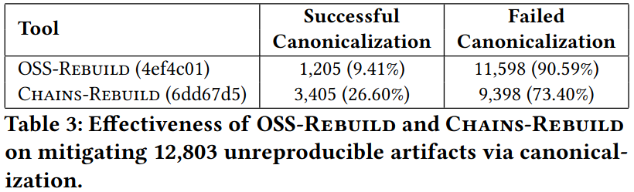
RQ2: Effectiveness of Artifact Canonicalization
Takeaway: 2.5x increase in canonicalized artifacts with only a few improvements.
OSS-Rebuild: Tool by Google to canonicalize software artifacts.
CHAINS-Rebuild: Fork of OSS-Rebuild with support for canonicalizing build manifests and embedded versioning properties.
19-11-2025
Aman Sharma | amansha@kth.se

Slide 30
RQ3: Effectiveness of Bytecode Canonicalization
We select a subset of unreproducible artifacts that have JVM bytecode changes.
This is 936/12,803 artifact pairs.
Reasons of failure:
Structural Changes limitation (eg. changes in order of methods, fields, etc)
Control flow limitation (eg. ifne and ifeq)
Embedded data (eg. absolute file paths)
Optimization limitation (eg. string concatenation)
 | Successful canonicalization | Failure in canonicalization | Error in canonicalization
# | 275 (29.4%) | 508 (54.3%) | 153 (16.3%)
19-11-2025
Aman Sharma | amansha@kth.se

Slide 31
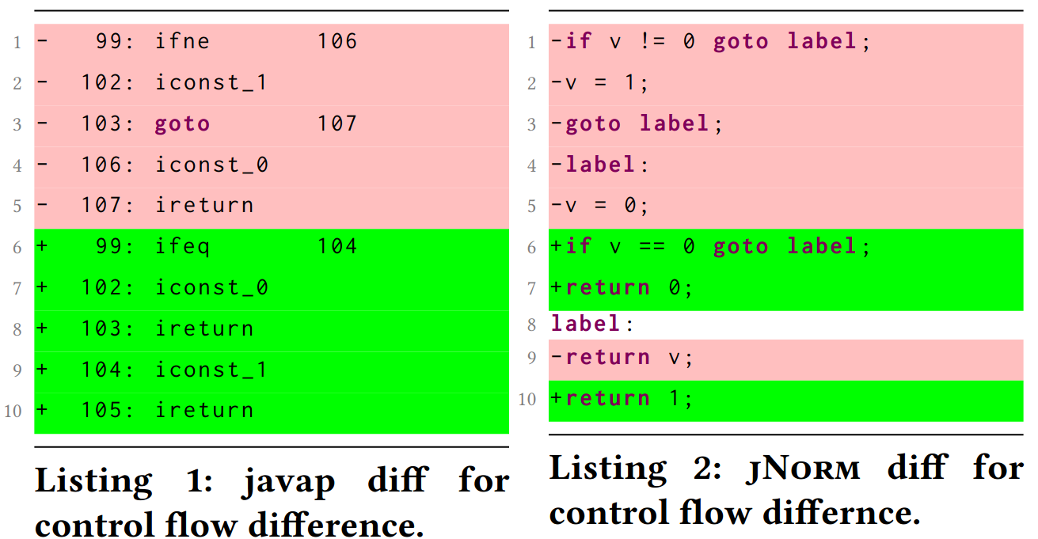
Example diff for jNorm
19-11-2025
Aman Sharma | amansha@kth.se

Slide 32
RQ3: Effectiveness of Bytecode Canonicalization
We select a subset of unreproducible artifacts that have JVM bytecode changes.
This is 936/12,803 artifact pairs.
Reasons of failure:
Structural Changes limitation (eg. changes in order of methods, fields, etc)
Control flow limitation (eg. ifne and ifeq)
Embedded data (eg. absolute file paths)
Optimization limitation (eg. string concatenation)
Takeaway: 4 categories of improvements for bytecode canonicalization.
 | Successful canonicalization | Failure in canonicalization | Error in canonicalization
# | 275 (29.4%) | 508 (54.3%) | 153 (16.3%)
19-11-2025
Aman Sharma | amansha@kth.se

Slide 33
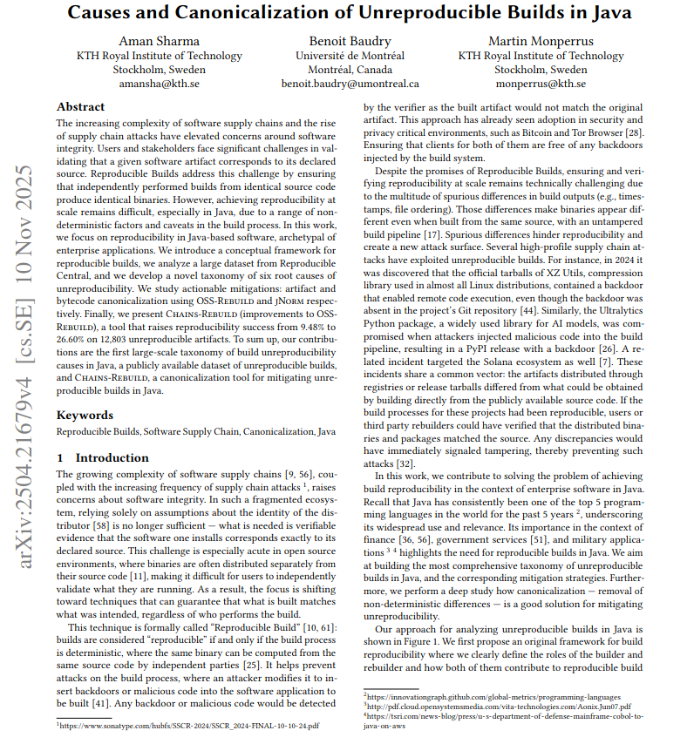
Paper:
Causes and Canonicalization of Unreproducible Builds in Java
Accepted at IEEE Transactions on Software Engineering
https://ieeexplore.ieee.org/document/11223991
19-11-2025
Aman Sharma | amansha@kth.se

Slide 34
Third goal
Integrate improvements in OSS Rebuild as part of internship at Google

Slide 35




What is OSS Rebuild?
Rebuilder infrastructure for applying reproducible builds at scale.
Internship Project
Results of paper
(Build Manifest & Versioning Properties)
Inference
Build
Semantic Compare
Reproducible
(No diff)
Package Identifier
Build Definition
8 Aug
\r\n
Diff
1)maven
2)io.github.chains-project:maven-lockfile
3)5.10.0
1)Repo-https://github.com/chains-project/maven-lockfile
2)Commit-219e4f3
3)Dir-maven_plugin
4)Build command …
22 Oct
\n
Non-
Reproducible
(Yes diff)
Registry
19-11-2025
Aman Sharma | amansha@kth.se
Notes:
// arrange it linearly so that you can referece it letter
// color for the different stages
// prefix or an icon for the problems (indicate that we are inference/build/comparison)
// explain the AI pipeline when it is needed when the solution
// fix the animation
// put “no diff” and “yes diff”

Slide 36
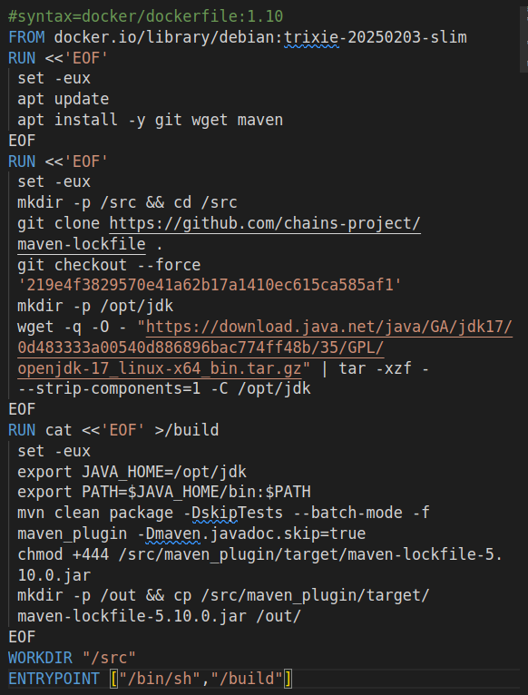
Reproducible Central
OSS Rebuild
groupId=io.github.chains-project
artifactId=maven-lockfile
version=5.10.0
gitRepo=https://github.com/chains-project/maven-lockfile.git
gitTag=${artifactId}-${version}
tool=mvn
jdk=17
newline=lf
command="mvn clean package -DskipDepClean -DskipTests -Dmaven.javadoc.skip -Dgpg.skip"
19-11-2025
Aman Sharma | amansha@kth.se

Slide 37
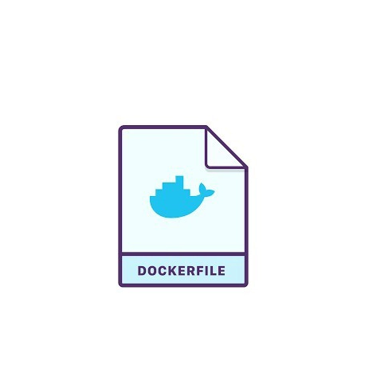

Rebuild Attestations
go run ./cmd/oss-rebuild/ get npm colors 1.4.0 --output=dockerfile
19-11-2025
Aman Sharma | amansha@kth.se

Slide 38
Running benchmark
Benchmark
spoon-core
maven-lockfile
preemptiv
go run tools/ctl/ctl.go run-bench attest demo.json --local --max-concurrency 3
go run tools/ctl/ctl.go tui --logs-bucket file:///tmp/oss-rebuild
Show results and diff which which failed to match the upstream artifact
19-11-2025
Aman Sharma | amansha@kth.se

Slide 39
Interpreting non-reproducibility
Not always indicative of malicious build. It can be:
Automation failure
Environmental differences
Non-deterministic builds
[24] https://github.com/google/oss-rebuild/blob/main/docs/trust.md
19-11-2025
Aman Sharma | amansha@kth.se
Notes:
// use numbered bullets
// bold text for inference, build, and comparison
// use diff blocks to define these reasons

Slide 40
Novel Features
Get repository URL using AI prompt
Get commit using matching upstream source
Infer build tool
Get JDK version bytecode version
Support for Gradle Builds
19-11-2025
Aman Sharma | amansha@kth.se

Slide 41
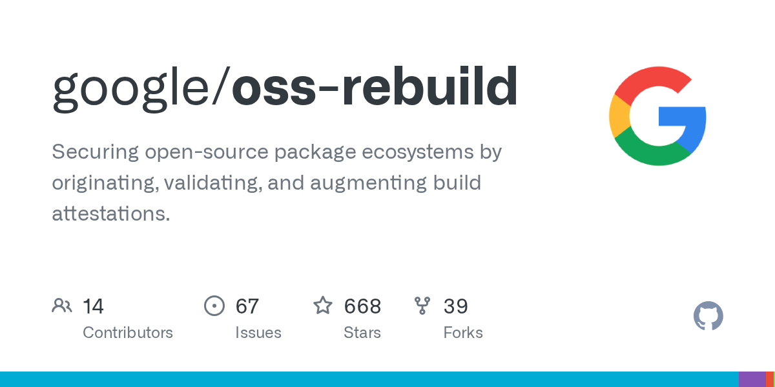
Matthew, William, and Teddy
19-11-2025
Aman Sharma | amansha@kth.se

Slide 42
Future Work
Multiple repositories in Maven as an attack vector
Leveraging reproducibility for build performance
Exploring Java Platform Module System
19-11-2025
Aman Sharma | amansha@kth.se

Slide 43
Conclusion
A comprehensive taxonomy of unreproducible builds in Java and their mitigation.
Artifact and bytecode canonicalization in conjunction can be used to mitigate unreproducibility.
OSS-Rebuild is awesome tool to build Java/NPM/PyPI/Cargo/Debian packages at scale.
19-11-2025
Aman Sharma | amansha@kth.se

